Slide 1
SOFTWARE EVOLUTION
Memoona Sami
Disclaimer: The contents in this presentation have been taken from multiple sources available at the internet including books, motes, reports, websites and presentations.

Slide 2
Disclaimer
The material used in this presentation i.e., pictures/graphs/text, etc. is solely intended for educational/teaching purpose, offered free of cost to the students for use under special circumstances of Online Education due to COVID-19 Lockdown situation and may include copyrighted material - the use of which may not have been specifically authorized by Copyright Owners. It’s application constitutes Fair Use of any such copyrighted material as provided in globally accepted law of many countries. The contents of presentations are intended only for the attendees of the class being conducted by the presenter.

Slide 3
Software Evolution
The process of developing a software product using software engineering principles and methods is referred to as software evolution. This includes the initial development of software and its maintenance and updates, till desired software product is developed, which satisfies the expected requirements.

Slide 4
The sooner you start to code, the longer the program will take. — Roy Carlson, University of Wisconsin

Slide 5
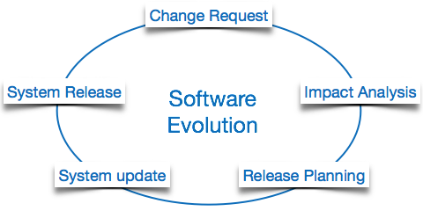
Software Evolution

Slide 6
Software Evolution
Evolution starts from the requirement gathering process. After which developers create a prototype of the intended software and show it to the users to get their feedback at the early stage of software product development. The users suggest changes, on which several consecutive updates and maintenance keep on changing too. This process changes to the original software, till the desired software is accomplished.

Slide 7
The advancing technology and the changing requirements force the software product to change accordingly. Re-creating software from scratch and to go one-on-one with requirement is not feasible. The only feasible and economical solution is to update the existing software so that it matches the latest requirements.

Slide 8
Software Evolution Laws
Lehman has given laws for software evolution. He divided the software into three different categories:
S-type
P-type
E-type

Slide 9
S-type (static-type)
S-type (static-type) - This is a software, which works strictly according to defined specifications and solutions. The solution and the method to achieve it, both are immediately understood before coding. The s-type software is least subjected to changes hence this is the simplest of all. For example, calculator program for mathematical computation.

Slide 10
P-type (practical-type)
P-type (practical-type) - This is a software with a collection of procedures. This is defined by exactly what procedures can do. In this software, the specifications can be described but the solution is not obvious instantly. For example, gaming software.

Slide 11
E-type (embedded-type)
E-type (embedded-type) - This software works closely as the requirement of real-world environment. This software has a high degree of evolution as there are various changes in laws, taxes etc. in the real world situations. For example, Online trading software.

Slide 12

Any Questions ??

